Slide 1


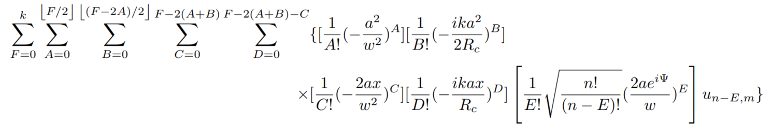
K-th order Shift, x transformation
For k-th order shift approximation (note that k is ambiguously used as wavenumber…):
Loop over this expression ∀ n and ∀ m in the set of tophat modes:
C_{nm}
X₊¹C_{nm}U_{n-E+1}
C_{nm}x^{C+D}U_{n-E}
C_{nm}xU_{n-E}
X₋¹C_{nm}U_{n-E-1}
Max x order = shift * tilt order

Slide 2


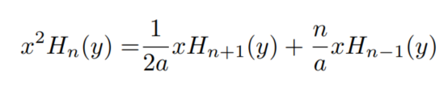
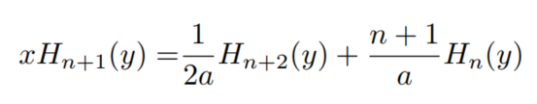

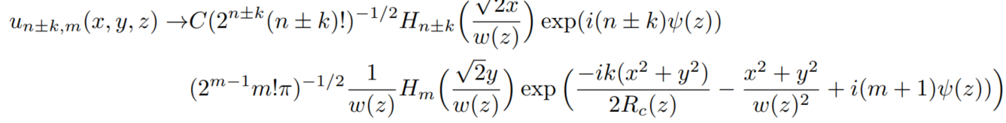
Section 3.2 of living doc

Slide 3
X₊^{1(n)}
X₋^{1(n)}
x²u_{n,m}
U_{n-E}
q1
X count = 2
q2
X count = 1
X₊^{1(n)} U_{n-E+1}
X₋^{1(n)} U_{n-E-1}
X₊^{1(n)} X₊^{1(n-E+1)}U_{n-E+2}
X₊^{1(n)}U_{n-E+1}
(X₊^{1(n)} X₊^{1(n-E-1)}U_{n-E}
+ X₋^{1(n)} X₋^{1(n-E+1)}U_{n-E})
PC_{nm}x²u_{n-E,m}
X₋^{1(n)}U_{n-E-1}
X₋^{1(n)} X₋^{1(n-E-1)}U_{n-E-2}
*P is some factor resulting from everything in the sums other than x
** Cnm and P suppressed in the diagram

Slide 4
X₊^{1(n,m)}
X₋^{1(n,m)}
X²u_{n,m}
q1
X₊^{1(n)}U_{n-E+1}
X₋^{1(n)}U_{n-E-1}
X₋^{1(n)}U_{n-E-1}
X count = 1
q2
X₊^{1(n)} X₊^{1(n-E+1)}
U_{n-E+2}
X₊^{1(n)} X₋^{1(n-E+1)}
U_{n-E}
X₋^{1(n)} X₊^{1(n-E-1)}
U_{n-E}
X₋^{1(n)} X₋^{1(n-E-1)}
U_{n-E-2}
X count = 0
X₊^{1(n)} X₊^{1(n-E+1)}U_{n-E+2}
X₊^{1(n)}U_{n-E+1}
(X₊^{1(n)} X₊^{1(n-E-1)}U_{n-E}
+ X₋^{1(n)} X₋^{1(n-E+1)}U_{n-E})
AC_{nm}X²u_{n-E,m}
X₋^{1(n)}U_{n-E-1}
X₋^{1(n)} X₋^{1(n-E-1)}U_{n-E-2}

Slide 5
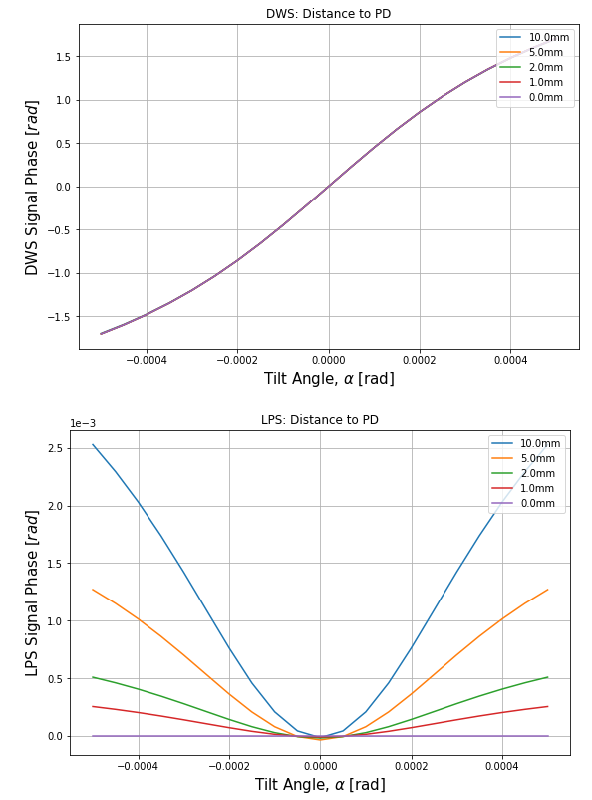
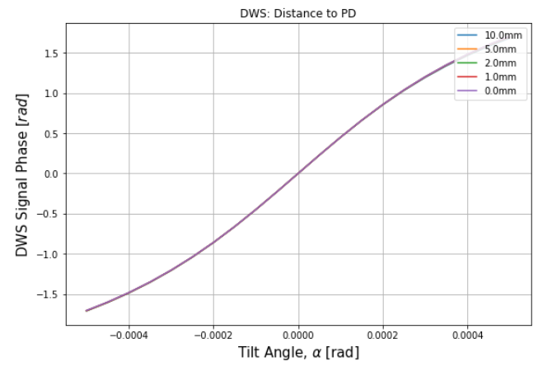
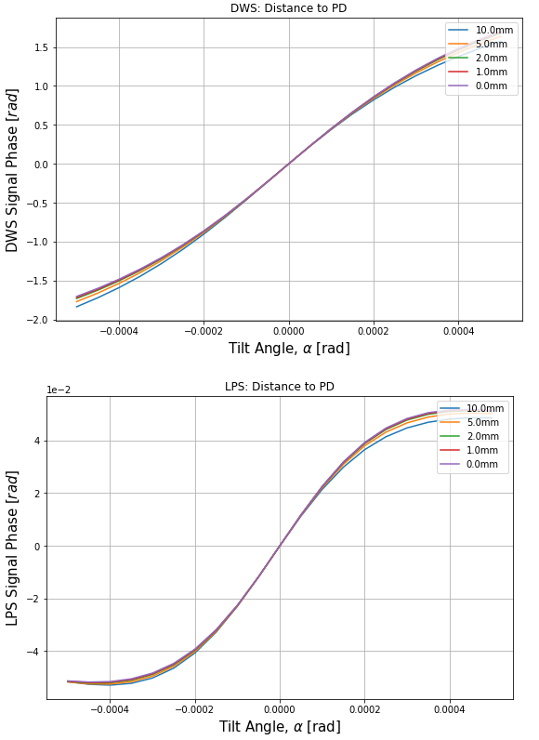
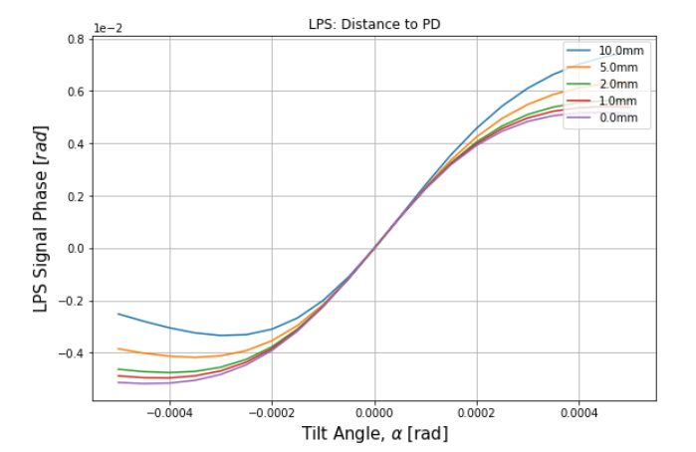
Original Basis (shift = 0,10,100 [um])

Slide 6
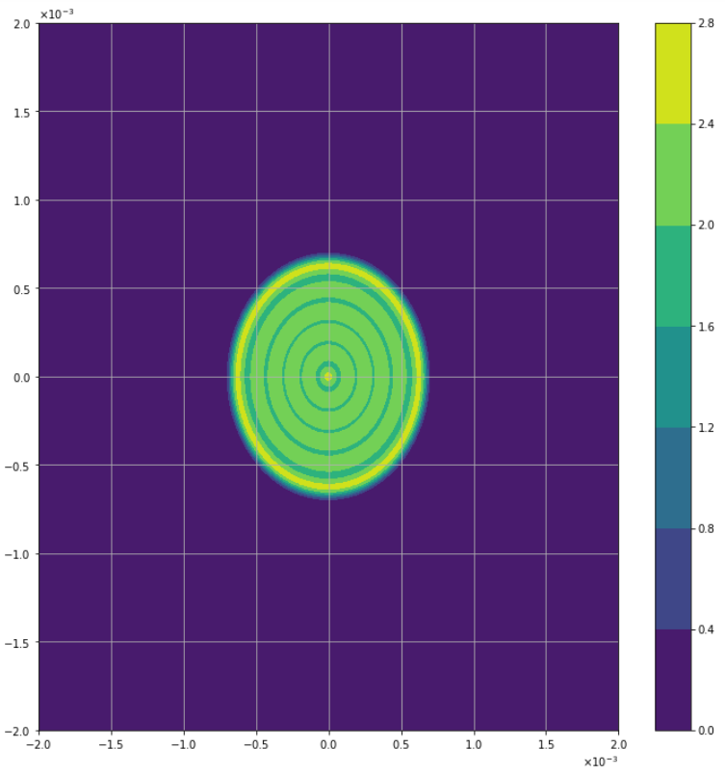
Radius = 1/3 aperture radius = 2/3 mm

Slide 7
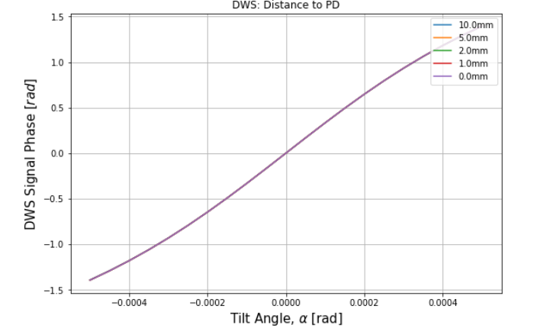
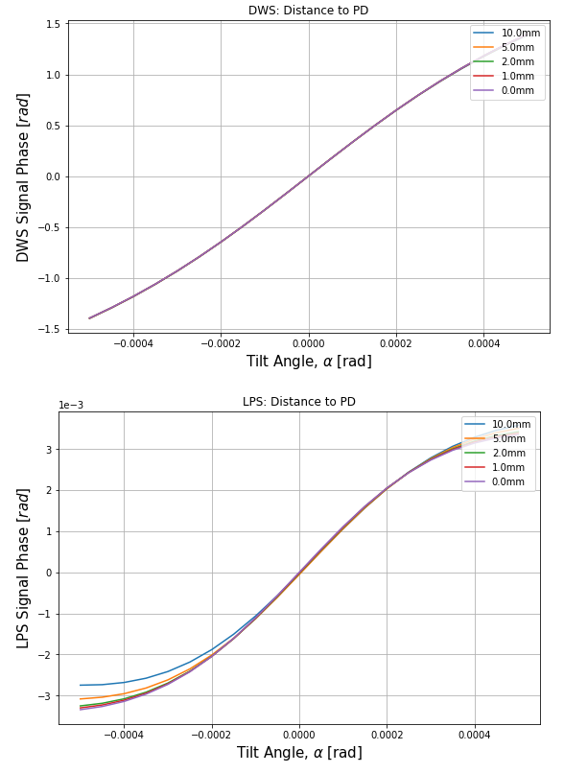
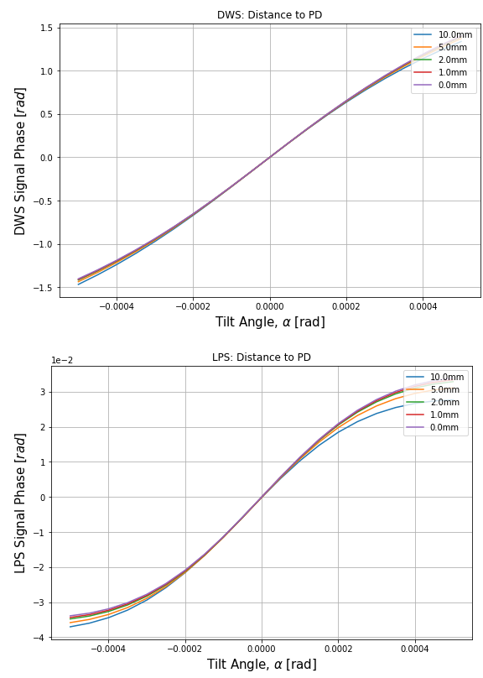
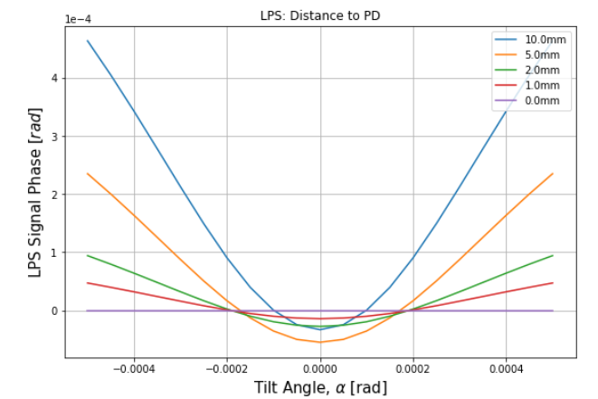
(shift = 0,10,100 [um])

